Slide 1

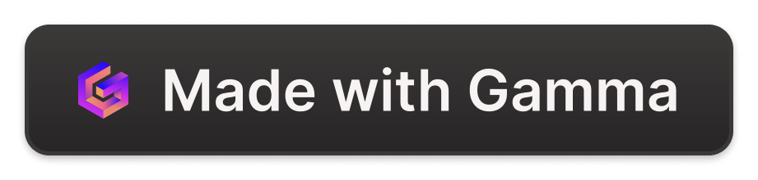
Fine Tuning vs. Retrieval-Augmented Generation (RAG)
This presentation explores the key differences between the two prominent machine learning techniques of fine-tuning and retrieval-augmented generation (RAG).
SA
by Shawaal Api

Slide 2

What is Fine Tuning?
Fine-tuning involves taking a pre-trained model and further training it on a specific task or dataset. This allows the model to learn task-specific knowledge while leveraging the generalizable features learned during the initial pre-training.

Slide 3

What is RAG?
Retrieval-Augmented Generation (RAG) is a technique that combines a language model with a retrieval system. The model generates output by retrieving relevant information from a knowledge base and then conditioning the generation on the retrieved context.

Slide 4
Differences in Model Architecture
Fine Tuning
RAG
The model architecture remains largely unchanged, with the final layers fine-tuned for the specific task.
The model architecture includes a retrieval component in addition to the generation component, allowing it to leverage external knowledge.

Slide 5

Differences in Training Process
1
Fine Tuning
The pre-trained model is further trained on a specific dataset, typically with a smaller learning rate.
2
RAG
The model is trained to effectively retrieve relevant information from a knowledge base and condition the generation on the retrieved context.
3
Hybrid Approaches
Some models combine fine-tuning and RAG, leveraging the strengths of both techniques.

Slide 6

Differences in Computational Complexity
1
Fine Tuning
2
RAG
Generally less computationally intensive, as it only requires fine-tuning the final layers of the model.
More computationally complex due to the additional retrieval component and the need to process the retrieved information.
3
Trade-offs
The increased complexity of RAG can be offset by the improved performance and flexibility it offers.

Slide 7

Differences in Flexibility and Customization
Fine Tuning
RAG
Limited flexibility, as the model architecture is largely fixed and only the final layers can be modified.
Higher flexibility, as the retrieval component can be customized to access different knowledge sources and the generation can be tailored to the specific task.
Hybrid Approaches
Combining fine-tuning and RAG can provide a balance of flexibility and performance.

Slide 8





Choosing Between Fine Tuning and RAG
Task Requirements
Computational Resources
Data Availability
Target Audience
Consider the specific task and the need for external knowledge or flexibility.
Assess the amount and quality of data available for fine-tuning or training a RAG model.
Determine the needs and expectations of the end-users, and choose the approach that best meets their requirements.
Evaluate the available computational power and the trade-offs between performance and complexity.

